Slide 1



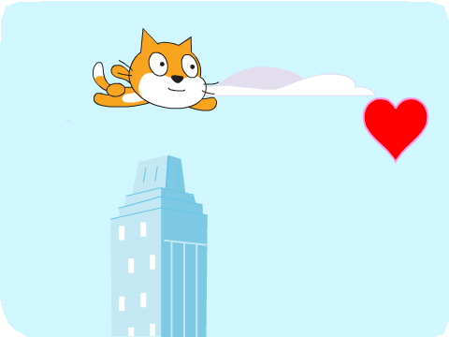
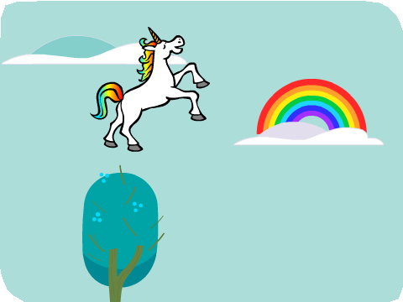
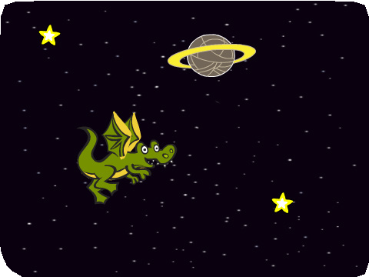
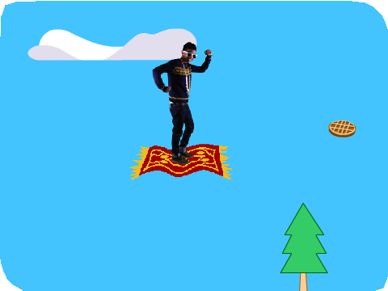


MAKE IT FLY / EDUCATOR GUIDE
MAKE IT FLY / EDUCATOR GUIDE
EDUCATOR GUIDE
Make It Fly
With this guide, you can plan and lead a one- hour workshop using Scratch. Participants will choose a character and program it to fly.
Workshop Overview
Here’s a suggested agenda for a one-hour workshop:
First, gather as a group to introduce the theme and spark ideas.
IMAGINE
10 minutes
Next, help participants as they create a flying animation, working at their own pace.
CREATE
40 minutes
At the end of the session, gather together to share and reflect.
SHARE
10 minutes
1
SCRATCH EDUCATOR GUIDE •
scratch.mit.edu/ideas
2

Slide 2

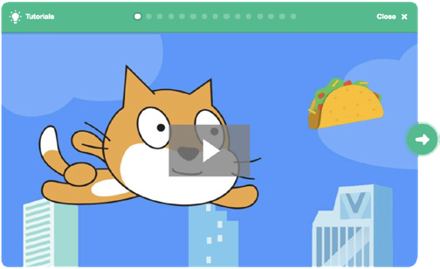
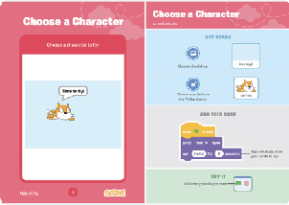
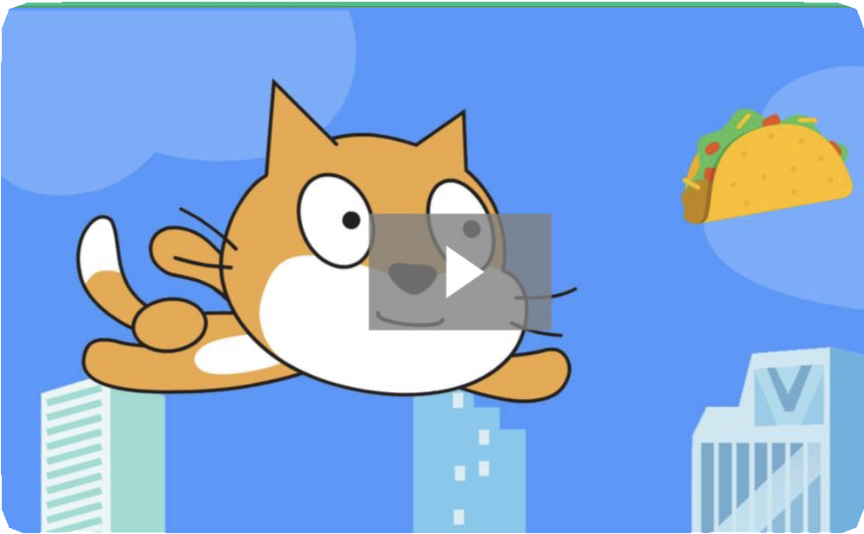
Imagine
MAKE IT FLY / EDUCATOR GUIDE
MAKE IT FLY / EDUCATOR GUIDE
Get Ready for the Workshop
Use this checklist to prepare for the workshop.
IMAGINE
Begin by gathering the participants to introduce the theme and spark ideas for projects.
Preview the Tutorial
The Make It Fly tutorial shows participants how to create their own projects. Preview the tutorial before your workshop and try the first few steps: scratch.mit.edu/fly
Print the Activity Cards
Print a few sets of Make It Fly cards to have available for participants during the workshop. scratch.mit.edu/fly/cards
Make sure participants have Scratch accounts
Participants can sign up for their own Scratch accounts at scratch.mit.edu, or you can set up student accounts if you have a Teacher Account. To request a Teacher Account, go to: scratch.mit.edu/educators
Set up computers or laptops
Arrange computers so that participants can work individually or in pairs.
Set up a computer with projector or large monitor
You can use a projector to show examples and demonstrate how to get started.
Warm-up Activity: If I Could Fly...
Gather the group in a circle and ask, “If you could fly, where would you want to go?” Suggest that they close their eyes and imagine flying through their favorite place. Ask, “Where are you? What kinds of things do you see below you?” If there’s time, have each person say where they imagined flying or something they saw on their flight.
Provide Ideas and Inspiration
Show the introductory video for the Make It Fly tutorial. The video shows a variety of projects for ideas and inspiration.
View at scratch.mit.edu/fly
or vimeo.com/llk/fly
3
SCRATCH EDUCATOR GUIDE •
scratch.mit.edu/ideas
4

Slide 3



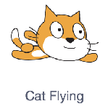


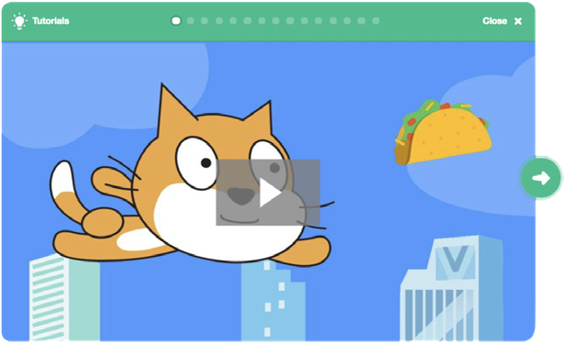
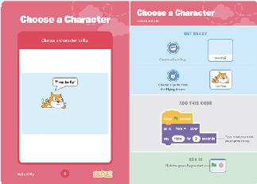
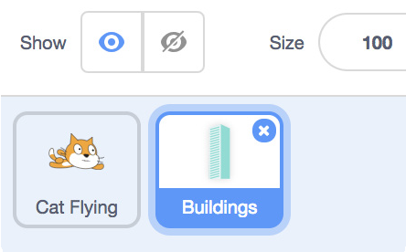
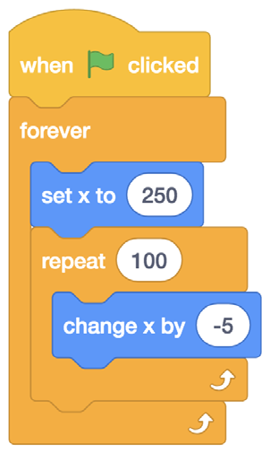

Create
MAKE IT FLY / EDUCATOR GUIDE
MAKE IT FLY / EDUCATOR GUIDE
Demonstrate the First Steps
IMAGINE
CREATE
Demonstrate the first few steps of the tutorial so participants can see how to get started.
Support participants as they make a flying animation.
In Scratch, click Create.
Choose a flying sprite from the library:
Start with Prompts
Ask participants questions to get started
What character would you like to make fly?
Where will your character go flying?
Choose a new sprite for your character to fly past:
Provide Resources
Offer options for getting started
Make the building move across the stage to make your character look like it’s flying:
Some participants may want to follow the online tutorial: scratch.mit.edu/fly
Others may want to explore using the activity cards: scratch.mit.edu/fly/cards
Suggest Ideas for Starting
Choose a character
Make the character say something
Choose buildings or other scenery
Make the scenery move
5
SCRATCH EDUCATOR GUIDE •
scratch.mit.edu/ideas
6

Slide 4


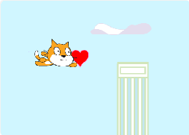
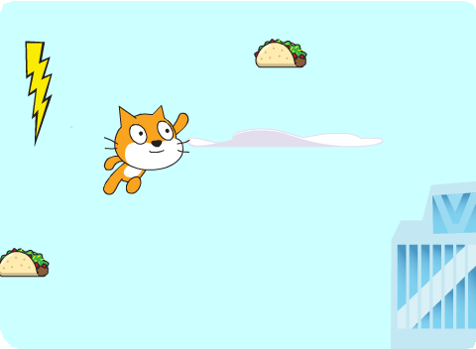
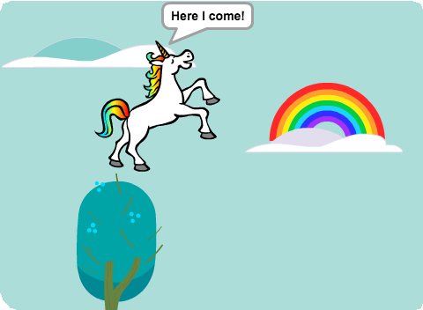
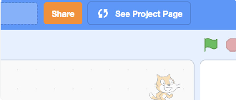

Share
MAKE IT FLY / EDUCATOR GUIDE
MAKE IT FLY / EDUCATOR GUIDE
CREATE
SHARE
More Things to Try
Switch costumes to change the scenery.
Make your character move when you press a key.
Add clouds and other floating objects.
Score points when touching an object.
Share projects with others in the room. Organize a flying character showcase. Ask half the room show their projects, while the others view them. Then switch.
Suggest that they ask each other questions, such as:
Encourage Debugging
Here are some strategies to suggest to help participants fix any bugs or difficulties they encounter:
When stuck, talk out what you’re working on with someone.
Try out small bits of code at a time to figure out what’s happening at each step.
Look closely at the blocks on the tutorial or activity cards to see if they are the same or different from the blocks you’re using.
Remember that bugs always arise when creating a computer program. Debugging is a helpful skill to know not just in coding, but throughout life.
What do you like best about the project you made?
What might you like to change or make next?
What’s Next?
Participants can use the ideas and concepts from this workshop to create other projects. Here are a couple of variations on the flying character project you could suggest.
Prepare to Share
To add instructions and credits to a project, click the button: “See project page”.
Give your project a title, add instructions and credits, then click Share.
Flying Game
Make a game where you avoid some objects and try to catch others. Add or subtract points based on what your character touches.
Flying Stories
Tell a story about your flying characters. You can record your voice and play sound clips. Or, use say blocks to make voice bubbles.
Scratch is a project of the Lifelong Kindergarten Group at the MIT Media Lab.
7
SCRATCH EDUCATOR GUIDE •
scratch.mit.edu/ideas
8

